Slide 1
Momentor How-To Guide
Maximizing the benefits of using Momentor for Coaching
Notes:
Behaviour change is challenging. Leaders don’t spontaneously wake up each morning and modify their approach to recognising talent, including them more in problem solving, decision making or planning processes or limiting their tendency to interrupt others while they are speaking.
In fact, research suggests that it takes about 4-8 weeks of deliberate practise before new neural circuits are strengthened and 30-90 days to develop a comfort level in truing new behaviours and having some basic level of competence.
Momentor was developed as a platform to translate insights from training and coaching into successful behaviour change enhancing leadership effectiveness associated with talent engagement, retention and productivity.

Slide 2
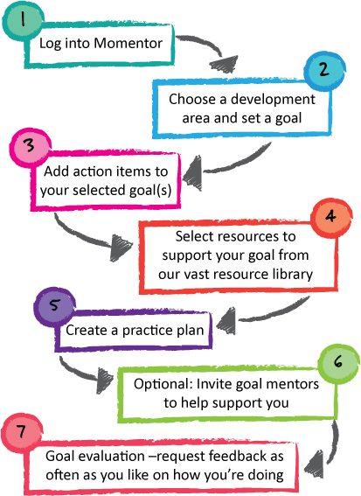
Notes:
Momentor incorporates the latest evidence based research in neuropsychology and habit/behaviour change in several features as well as provides a unique tool for evaluating actual behaviour change (Kirkpatrick levels 2-3) to provide a metric of ROI for your 360-degree feedback intervention.

Slide 3
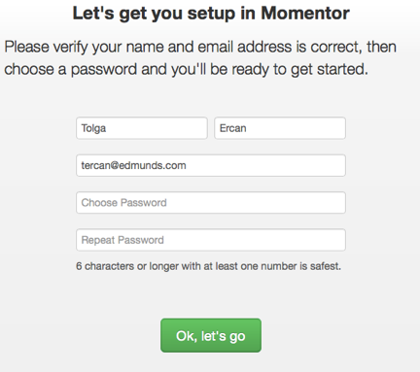
Log in…
You will receive a link via email inviting you to begin your development journey, using Momentor..
Notes:
Program participants from training programmes are sent an email from our Momentor administration system to invite them to begin their development journey resulting in an online professional development plan and structured practise sessions to leverage their strengths and/or focus on possible development opportunities based on the training or coaching goals.

Slide 4
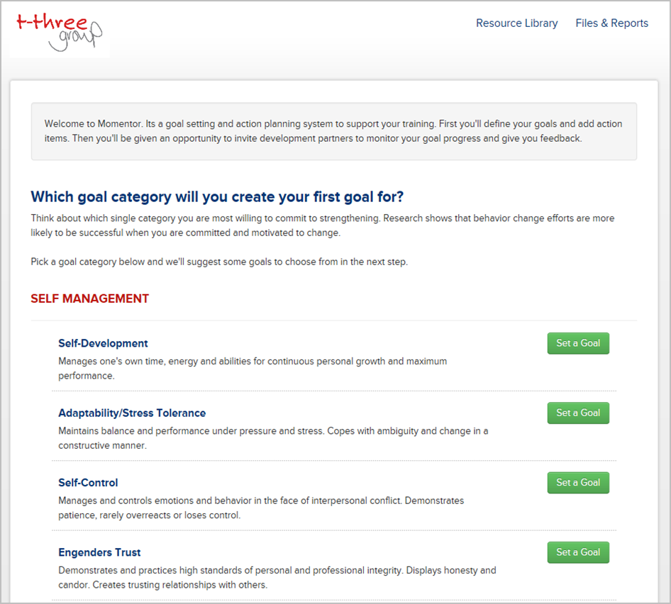
Creating your first goal
Notes:
Momentor begins the development journey focusing on one or more competencies that are integrated with your training and/or coaching goals. These are pre-loaded once we set up Momentor for you based on the type of training or coaching you are doing.
Tip 1: It is recommended that leaders focus initially on no more than 1 or 2 goals
Tip 2: You can come back at any time during the 12-month subscription and work on additional development goals!

Slide 5
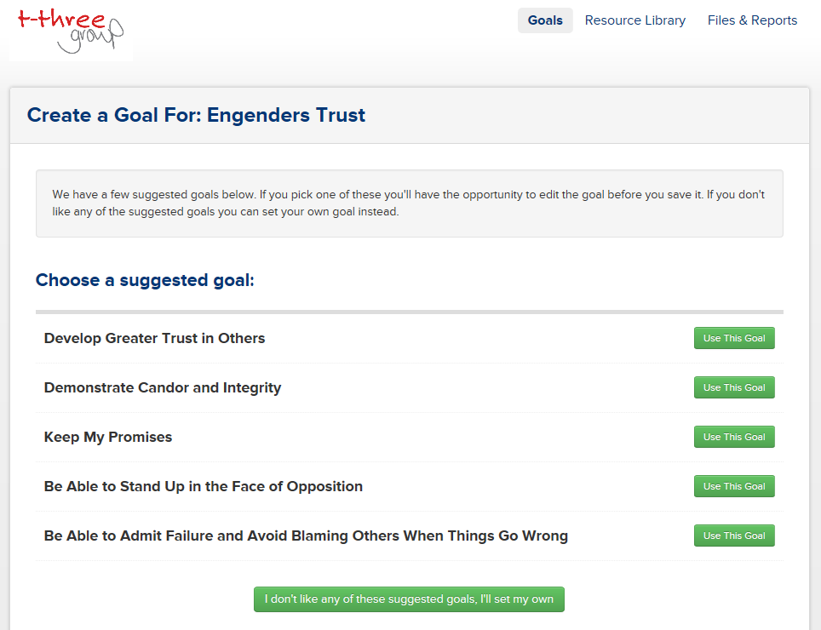
Creating a goal
Choose a suggested goal related to the particular category you have selected.
Or alternatively if you prefer, you can click here to set your own personalised goals
Notes:
Momentor will automatically suggest 5 generic goals but you can write your own in a way that when you go out in the future to get evaluation feedback – writing it in a way that is clear and measureable – someone can observe whether you have changed your behaviour.
These become your “outcome based goals” that will be evaluated using the feedforward “goal evaluation” feature at any time within Momentor

Slide 6
Finalizing the goal
Notes:
Up until this point Momentor will keep nagging you politely until the end date you’ve submitted – until the end date when Momentor will encourage seek evaluation feedback.
Positive reminders (“nudge psychology”) have been shown to be strongly associated with maintenance of new behaviours based on research in the health psychology field and the work of University of Chicago economists Richard H. Thaler and Cass R. Sunstein
http://www.local.gov.uk/documents/10180/11463/Changing+behaviours+in+public+health+-+to+nudge+or+to+shove/5ae3b9c8-e476-495b-89b4-401d70e1e2aa

Slide 7
Setting a timeline
Notes:
Momentor uses a 3-step outcome goal setting process that includes:
Writing the goal outcome
Creating a date for reminder to evaluate goal progress
Inviting an unlimited number of developmental partners (goal mentors) to reinforce, support and provide ongoing feedback via email to the leader

Slide 8
Momentor will remind you..
Momentor sends out a reminder email every week asking you about your progress and reminding you of your goals.
You can find all your trackable activity in your development feed.
Notes:
Although we are all overwhelmed with email, Momentor uses this form of “nudging” to gently encourage successful completion of their development plan goals. The leader can change the frequency of receiving these emails (default is once per week) if they prefer.

Slide 9
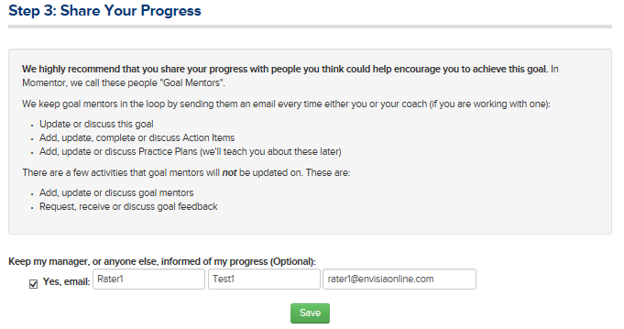
Invite goal mentors
Notes:
This is optional – email based, confidential – goes directly to the goal mentor’s inbox – they won’t see your report or evaluation data but will see action items and practice plans.
Support network of people – we need peer support, cheerleaders, development partner, champion – strong research to support sustainable behaviour change support is needed – support groups was a critical step
When thinking about who to select as a goal mentor it might be someone who has particular expertise around the goal you have chosen – this could be your manager & if your organisation has an informal/formal mentoring process consider inviting

Slide 10
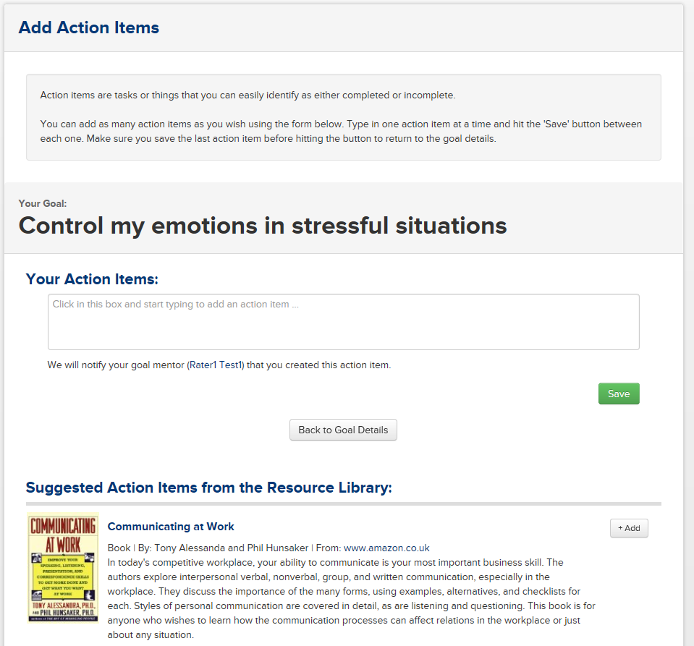
Adding Action Items
Action items are tasks or things that you can easily identify as either completed or incomplete. Add your own or select from our recommended action items from our resource library.
Once you have added actions, click the ‘Back to goal details’ button
The next step is to click on ‘Teach me about practice plans’.
Notes:
Momentor will suggest 25 top action items taken from its extensive competency based resource library. Some simple one off activities (e.g., read this article/book watch a podcast) that are arguably less useful for sustained behaviour change over time than actual practise (70:20:10 rule of talent development based on research by the Center for Creative Leadership).
Leaders can also add their own action items at any time for each of their goals.
Action items are ideally used as away to enhance knowledge, background reading, research, raise some questions, and learn more about their goal focus.

Slide 11
Practice Plans
Practice Plans have two parts.
Momentor prompts you to share your practice plans with your goal mentor..
The second part is what you commit to do more, less or differently when you experience the trigger
The first is the situation, or the trigger, where you'd like to behave differently
Notes:
Momentor uses the latest research(Gollowitzer and colleagues) on what psychologists call “implementation intentions” using a two-step process:
Triggers of behaviour (either time based or situation based such as “Monday/Wednesday/Friday at 6am” or “When I am in my weekly staff meetings”
Specification of the actual behaviour to practise
Momentor provides a structure for answering the question of “How long should I practice?” as it depends on the complexity of the goal and often realistically people can observe it
How often have you practiced and how often can people observe it.
Current research suggests that a leader needs 30 – 90 days of deliberate and varied practice (e.g., if you want to become a better runner – interval training) to make the new behaviour become automatic (a habit) and to successful maintain it over time.

Slide 12
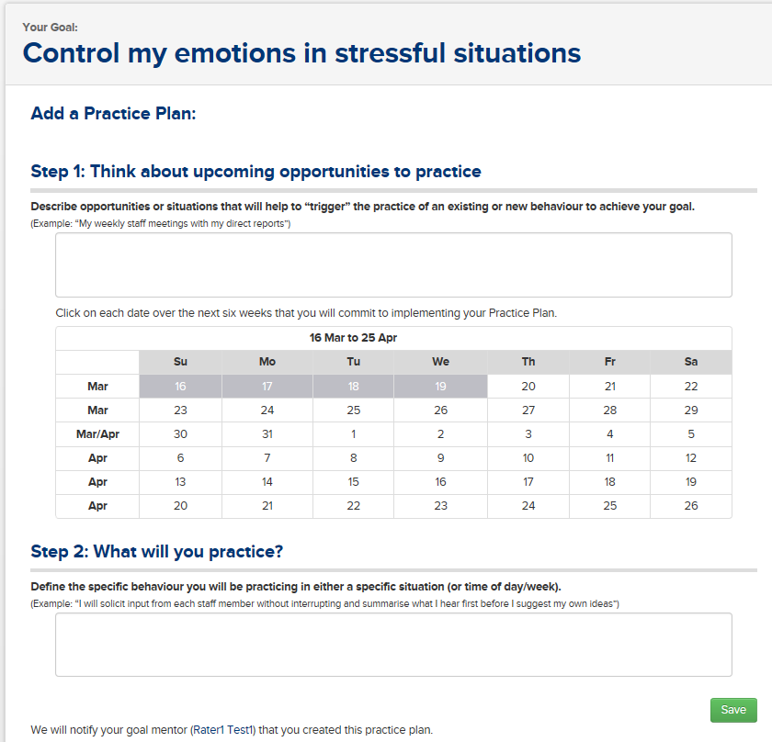
Practice Plans
Notes:
Momentor provides visual diaries to help your trigger times – and commit to do something at a behavioural level more, less, or differently.
Once you set up a Practise Plan, Momentor will send out a unique reminder to “nudge” you into action.
You can set up an unlimited number of “practise plans” for each goal.

Slide 13
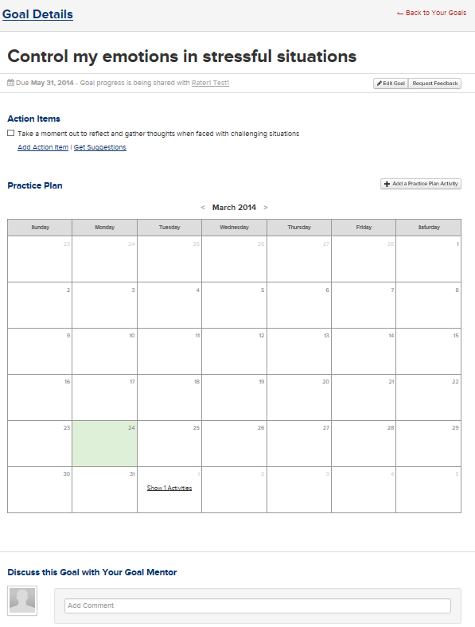
Summary Page
Notes:
Once you set up a Practise Plan, Momentor will send out a unique reminder to “nudge” you into action.
You can set up an unlimited number of “practise plans” for each goal.

Slide 14
Momentor Reminds You about your Practice Plans
Momentor sends out a specific reminder to prompt participants to put their practice plans into action
Notes:
Although we are all overwhelmed with email, Momentor uses this form of “nudging” to gently encourage successful completion of their practice plans once they have scheduled them.

Slide 15
Evaluate – Feedback on your Development Progress
After a period of time of practicing your Vital Few in line with your Practice Plan, request feedback..
You can (and are encouraged to) seek and invite feedback from a range of individuals on your development progress for example your line manager, goal mentors and colleagues/peers/direct reports
Use the button on the Practice Plan summary page to ‘Request Feedback’ or by clicking on Goals at the top taking you to Your Goals – click on show details and you can ‘Request Feedback’ from here too.
Notes:
One of the great features about Momentor is the ability to take a “progress pulse” and solicit feedback about goal progress at any time and from an unlimited number of raters.
This feature is based on the research of Marshall Goldsmith and his published “feedforward” evaluation approach.
http://www.marshallgoldsmithlibrary.com/cim/articles_display.php?aid=110

Slide 16
Momentor will remind you..
Momentor sends out a specific reminder to prompt participants to initiate goal feedback after deliberate practice to measure goal success and progress
Notes:
Although we are all overwhelmed with email, Momentor uses this form of “nudging” to gently encourage successful completion of their development plan goals. The leader can change the frequency of receiving these emails (default is once per week) if they prefer.

Slide 17
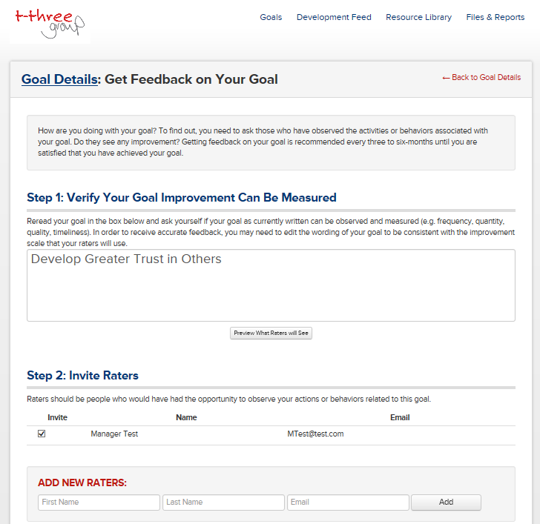
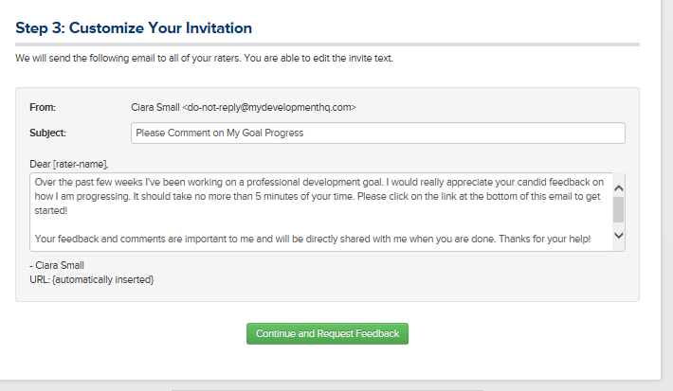
Evaluate
Verify the goal you have been working on
Then invite raters to provide feedback on your progress– this can be for example, from your peers, your goal mentors, your line manager etc.
You can also customise your invitation text..
Notes:
One great feature of Momentor is the ability to see goal evaluation as often as you like!
And, from as many individuals as you would like to invite (the same or even different ones).

Slide 18
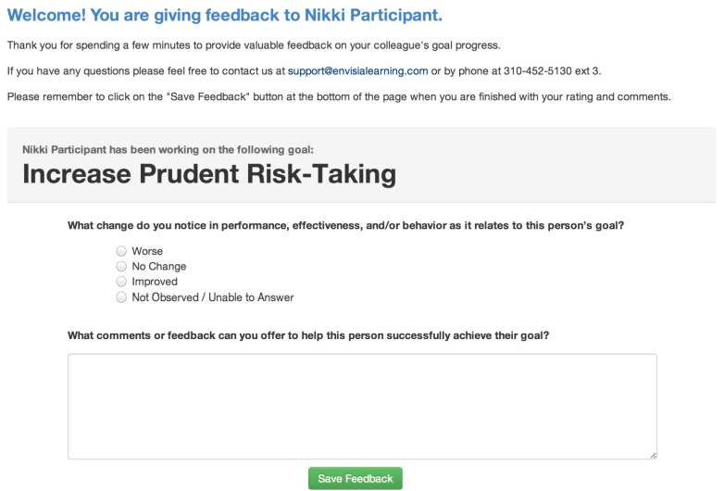
What your feedback nominees will receive
Notes:
Invited raters are sent an email evaluation that takes no more than a few minutes to complete.
Raters can also provide brief comments to help the leader understand and continuously improve their performance.
Once done, the leader is notified by Momentor to log back in and review their feedback results.

Slide 19
Remember…
Momentor Goal Evaluation:
Is NOT a reassessment of your initial 360 feedback assessment
Provides you with robust, tangible data to support your effective development and behavior change
Will provide you with a real sense of personal achievement and motivation when you see the results of your efforts being recognised.

Slide 20
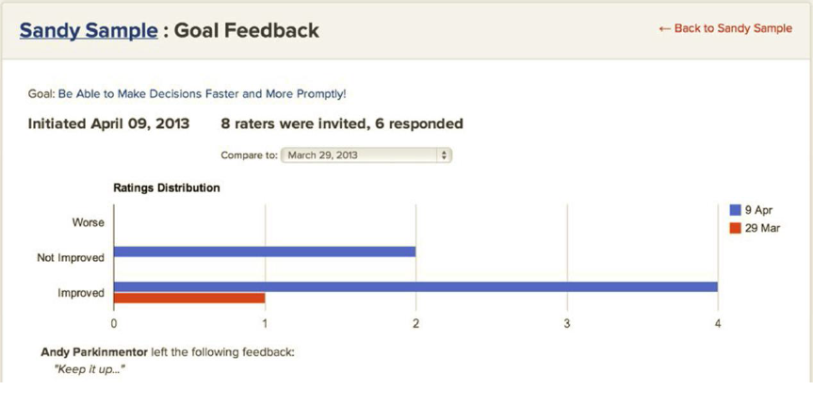
How will you know you’ve improved
Notes:
Momentor provides a graphic summary of goal feedback results to show continuous improvement over time.
The participant can compare and contrast goal progress to track how successful they have become with each goal they are working on as part of their professional development plan.

Slide 21
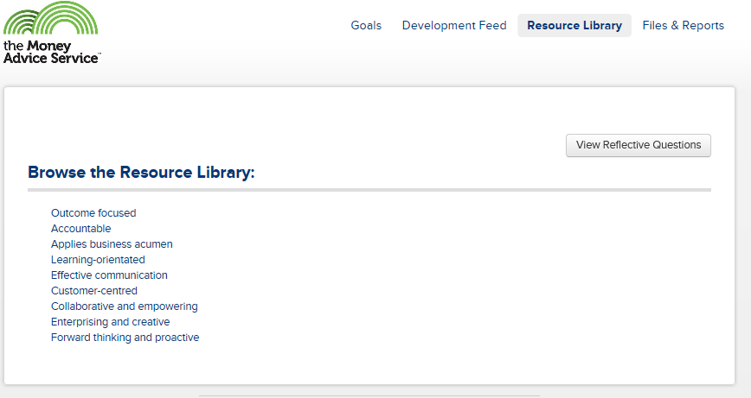
Using the Resource Library Particular resources will be suggested in line with the goals you have created, however, you can click on the Resource Library Tab at anytime to explore the entire library
You can access a wide selection of…
Articles
Audio
Books
On-the-job activities
Video
Websites/ blogs
Workshops/ Seminars
Your resource library will be based on, and linked to, your specific competency model
Notes:
Momentor provides a comprehensive competency based resource library for 12-months. It is constantly updated by a team of human resource professionals to include the latest resources.
Links to download and purchase books are included and all articles except for Harvard Business Review are part of the actual resource library.

Slide 22
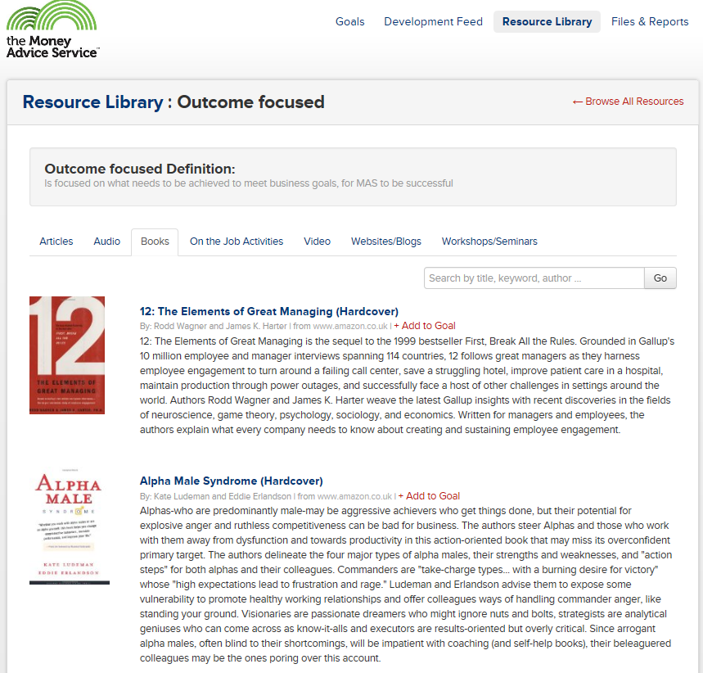
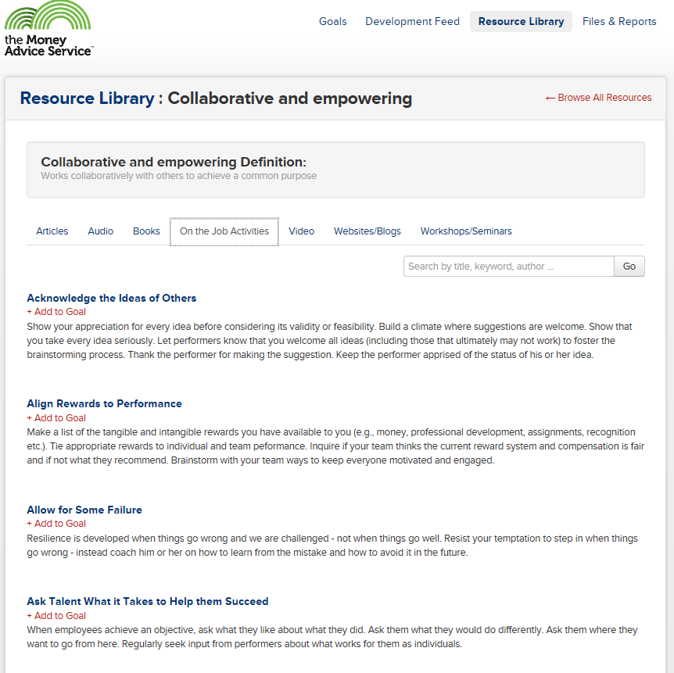
Content is maintained and updated weekly by a dedicated team of HR and OD Momentor professionals

Slide 23
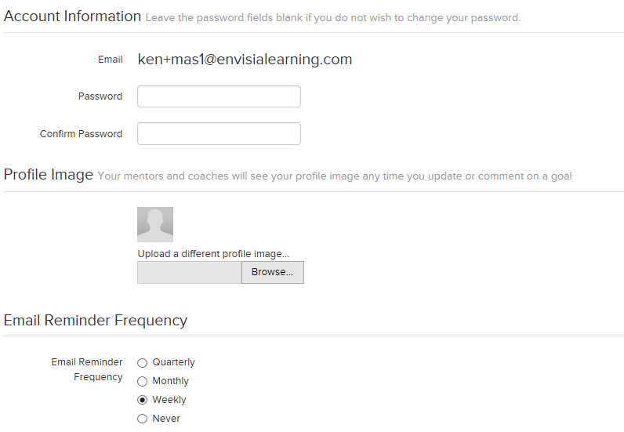
Settings in Momentor
Notes:
Leaders can change email reminder frequency and their log-in password at any time.
The default for email reminders is weekly.

